Slide 1

Integration of I 4.0 standards
Alina Arunova, Maxim Maltsev, Philipp Matyash, Sattar Rahimbeyli
Tutor: Irlán Grangel

Slide 2


What is “I 4.0 standards” ?
I 4.0 or Industry 4.0 is a combination of production methods with state-of-the-art information and communication technology. In the world of Industry 4.0, people, machines, equipment, logistics systems and products communicate and cooperate with each other directly.
4

Slide 3
The problem behind it?
The Problem
Globalization forces large companies to go international
Multinational companies tend to consolidate the standards
Different industrial standards need to be matched
Lots of time wasted onto manual object notation transcription
2

Slide 4
Goal
The Solution
validates each document against standard schema
matches each entity of the document to a respectful entity of another document if possible according to ontology
consolidate the knowledge into the new unified standard
3

Slide 5
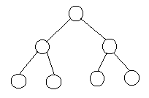
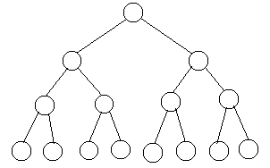
Visualisation of the process
AML – ontology
&
OPCUA – ontology
AML file
AML file
Integration file
OPCUA file
OPCUA file
All files are in XML format
5

Slide 6
Functional Requirements
High Priority:
Provide automatic document validation
Visualizing input (tree mode)
Direct topology mapping and producing integration file
Low Priority:
Demo testing of the output against Gold Standard
SPARQL query for the output file
3

Slide 7
Non-functional Requirements
High Priority:
Security and fault tolerance
Low Priority:
Time tolerant processing
Scalability
Semantic fuzzy matching
User-friendly interface
3

Slide 8
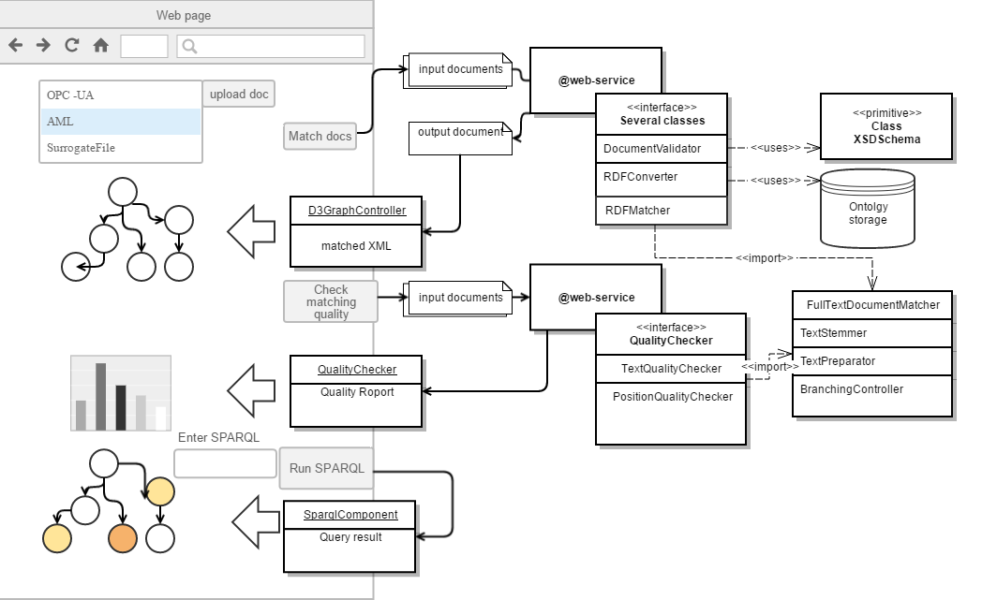
Architecture
2

Slide 9
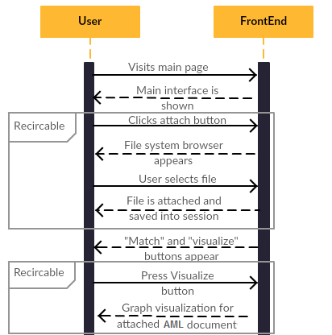
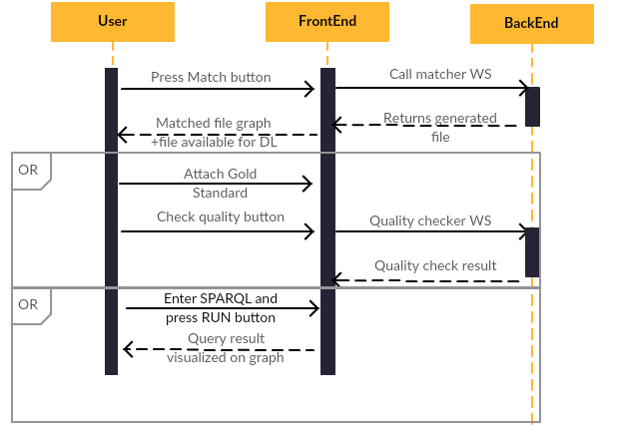
Visualisation of the workflow
3

Slide 10


Responsibilities
Sattar
Max
Phil
Alina
High-level plan
Requirements
Code specifications for Front-end;
User-manual.
Architecture;
Code specifications for Back-end;
System overview.
4

Slide 11
Workplan
Front end
01.06 – 01.07
Implementing the possibility of file uploading;
Visualizing the data (in XML format).
01.07 – 01.08
Implementing the possibility of browsing in the achieved result.
01.08 – 01.09
Testing of created tools;
Creating specifications and documents.
Back end
01.06 – 01.07
Development and realization of matching logic.
01.07 – 01.08
Development and realization of transport and security logics.
01.08 – 01.09
Testing of created tools;
Creating specifications and documents.
4

Slide 12
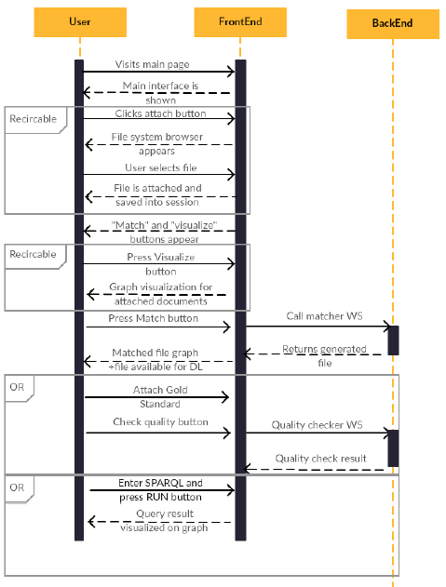
Use Case Diagram
3

Slide 13





Required tools
Conceptual tech stack
7

Slide 14
Test cases:
3

Slide 15
Challenges
3

Slide 16
Results after implementation
3

Slide 17
Integration of I 4.0 standards
Q&A?
Thanks!
6

